Slide 1

Foundation PHYSICS
Seminar 6: ELECTRIC FLUX & electric potential

Slide 2
Learning outcomes
Students will be able to apply critical thinking and analytical skills to solve problems regarding:
Applications of Gauss’s Law
Electric Field and Electric Potential
Electrical Energy and Work

Slide 3
Practice Questions
Why are equipotential surfaces perpendicular to electric field lines?
Why are equipotential surfaces closer in regions of large electric fields compared to regions of lower electric field?

Slide 4

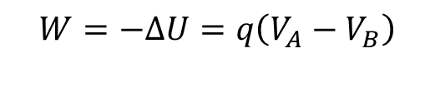
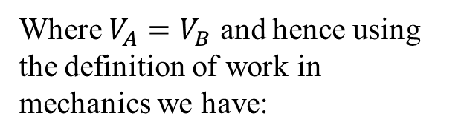

ANSWER: Practice Question 1
Reason for field lines to be perpendicular to equipotential surfaces
A surface on which every point has the same potential is called an equipotential surface.
Method 1: The work done to move a charge between two points (say points A and B) of an equipotential surface is always zero given that:
$$W=−∆U=q\left(V_{A}−V_{B}\right)$$
Where $V_{A}=V_{B}$ and hence using the definition of work in mechanics we have:
0$=F∙d∙cosθ$
0$=q∙E∙d∙cosθ$
Where d is an arbitrary displacement between the two points. From the above formula given that the product of the three quantities is zero, for arbitrary E, d and q that implies that cos(θ)=0 and hence the angle between the displacement and electric field is 90 degrees.

Slide 5
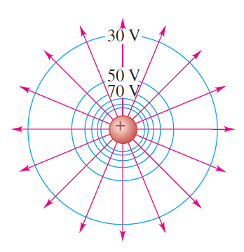
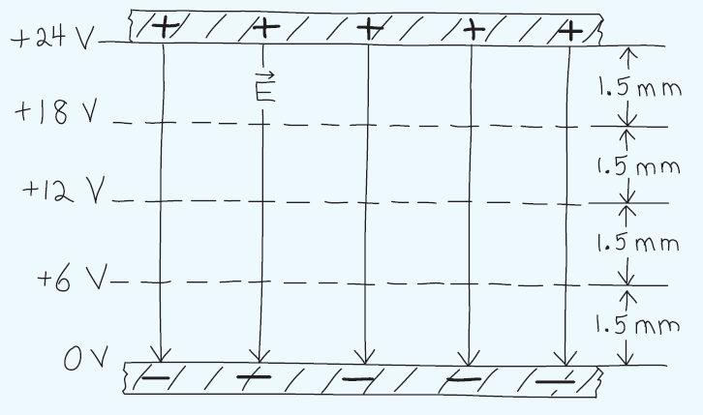

ANSWER: Practice Question 1
Method 2 (qualitative): Reason for field lines to be perpendicular to equipotential surfaces
$$W=q∙E∙d∙cosθ$$
If the electric field here is not perpendicular to the equipotential surface then there exists a non-zero component of the field along the surface.
Hence some work will be done against/by this field when charge moves along the surface which would then contradict the definition of the equipotential surface because this work would increase or decrease the potential energy of the charge.

Slide 6
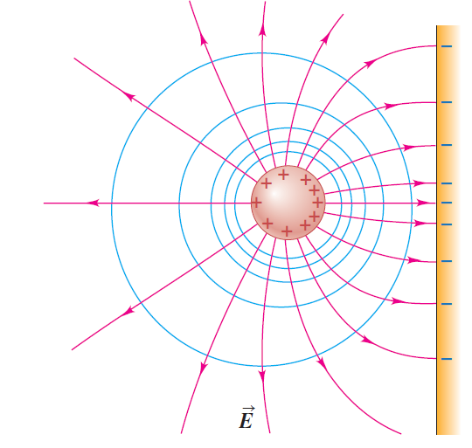
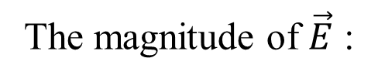
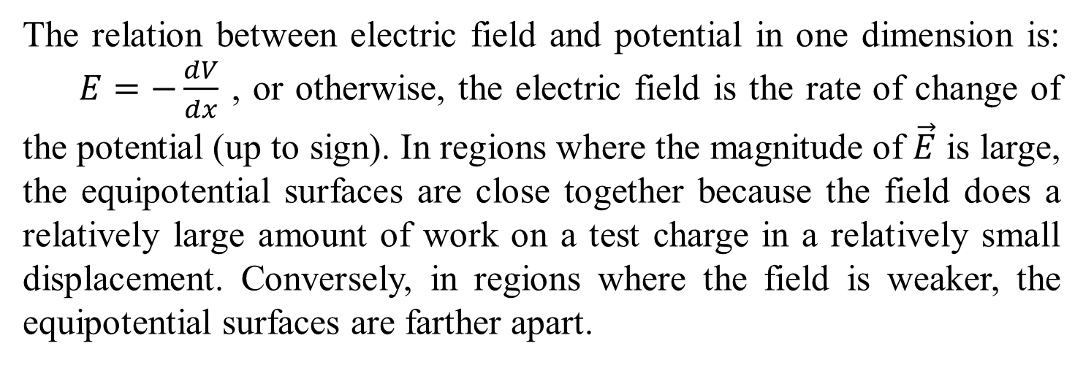
ANSWER: Practice Question 2
The magnitude of $\vec{E}$ :
The relation between electric field and potential in one dimension is: $E=−\frac{dV}{dx}$ , or otherwise, the electric field is the rate of change of the potential (up to sign). In regions where the magnitude of $\vec{E}$ is large, the equipotential surfaces are close together because the field does a relatively large amount of work on a test charge in a relatively small displacement. Conversely, in regions where the field is weaker, the equipotential surfaces are farther apart.

Slide 7
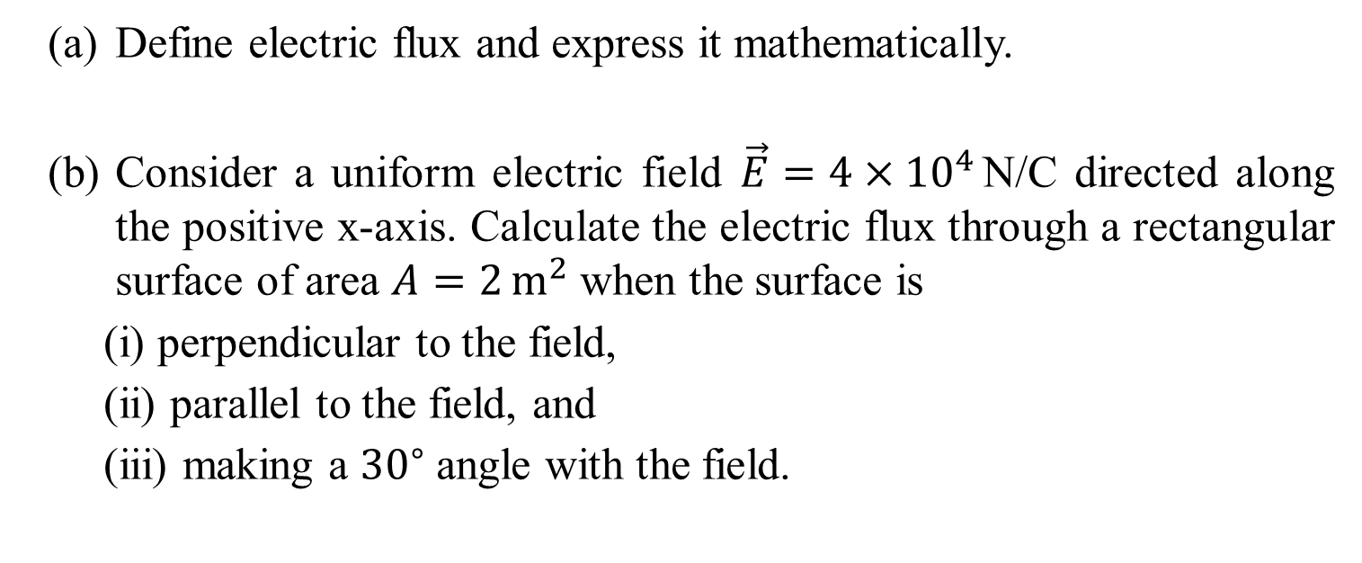
Question 1
Define electric flux and express it mathematically.
Consider a uniform electric field $\vec{E}=4×{10}^{4}$N/C directed along the positive x-axis. Calculate the electric flux through a rectangular surface of area $A=2 m^{2}$ when the surface is
(i) perpendicular to the field,
(ii) parallel to the field, and
(iii) making a ${30}^{∘}$ angle with the field.

Slide 8
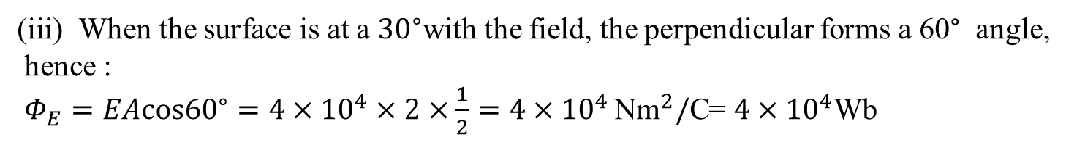
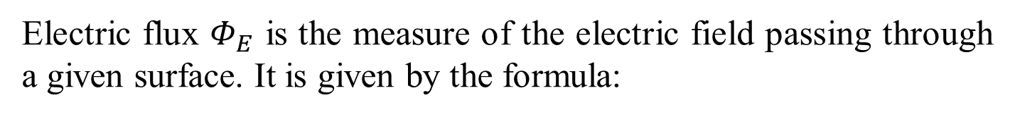

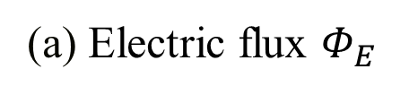
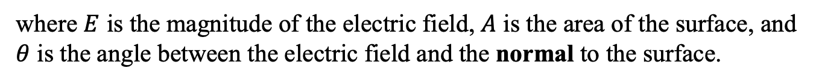

Question 1: ANSWER
(a) Electric flux $Φ_{E}$
Electric flux $Φ_{E}$ is the measure of the electric field passing through a given surface. It is given by the formula:
$$Φ_{E}=\vec{E}⋅\vec{A}=EAcosθ$$
where $E$ is the magnitude of the electric field, $A$ is the area of the surface, and $θ$ is the angle between the electric field and the normal to the surface.
(b) For the given scenarios
(i) Perpendicular: $θ=0^{∘}$, so $Φ_{E}=EA=4×{10}^{4}×2=8×{10}^{4} {Nm}^{2}/$C
(ii) Parallel: $θ={90}^{∘}$, so $Φ_{E}=0$
When the surface is at a ${30}^{∘}$with the field, the perpendicular forms a 60° angle,
hence :
$Φ_{E}=EAcos{60}^{∘}=4×{10}^{4}×2×\frac{1}{2}=4×{10}^{4} {\text{Nm}}^{2}/\text{C}$= $4×{10}^{4}$Wb

Slide 9
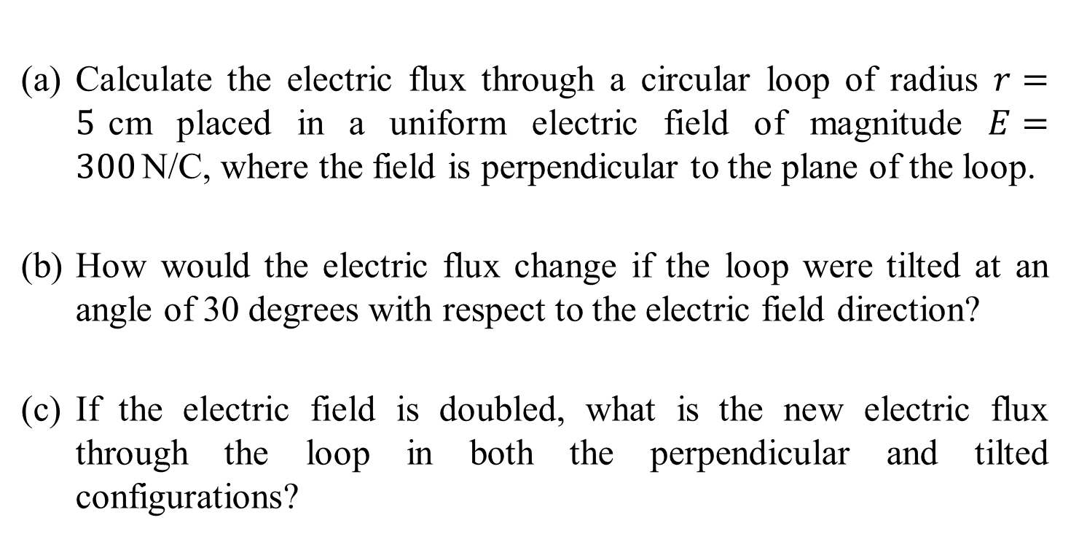
Question 2
Calculate the electric flux through a circular loop of radius $r=5$cm placed in a uniform electric field of magnitude $E=300$N/C, where the field is perpendicular to the plane of the loop.
How would the electric flux change if the loop were tilted at an angle of 30 degrees with respect to the electric field direction?
If the electric field is doubled, what is the new electric flux through the loop in both the perpendicular and tilted configurations?

Slide 10
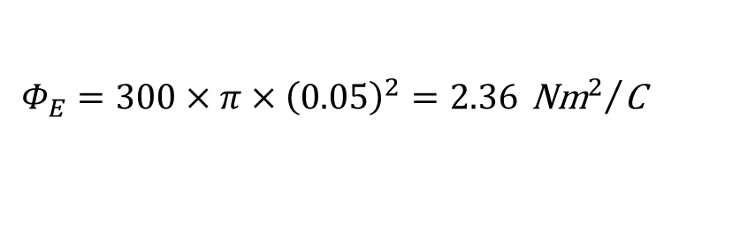

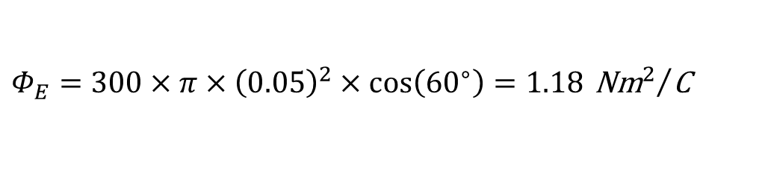

Question 2: ANSWER
(a) Flux Calculation for Perpendicular Field
$$Φ_{E}=E⋅A=E⋅πr^{2}$$
$$Φ_{E}=300×π×{\left(0.05\right)}^{2}=2.36 {{\text{Nm}}^{2}}/{\text{C}}$$
(b) Flux Calculation for tilted surface:
$$Φ_{E}=E⋅A⋅cos\left(θ\right)$$
$$Φ_{E}=300×π×{\left(0.05\right)}^{2}×cos\left({60}^{∘}\right)=1.18 {{\text{Nm}}^{2}}/{\text{C}}$$

Slide 11

Question 2: ANSWER
(c) Flux for doubled field:
Perpendicular: $Φ_{E}=2×2.36=4.72 {Nm}^{2}/$C
Tilted: $Φ_{E}=2×1.18=2.36 {Nm}^{2}/$C

Slide 12
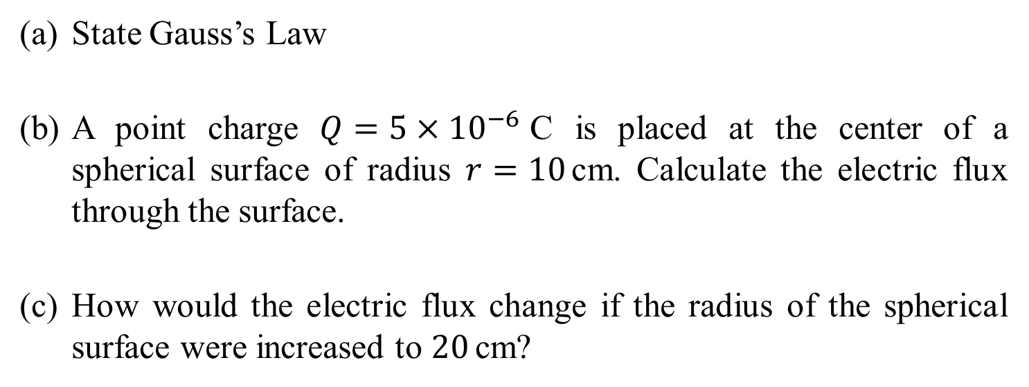
Question 3
State Gauss’s Law
A point charge $Q=5×{10}^{−6}$C is placed at the center of a spherical surface of radius $r=10$cm. Calculate the electric flux through the surface.
How would the electric flux change if the radius of the spherical surface were increased to $20$cm?

Slide 13
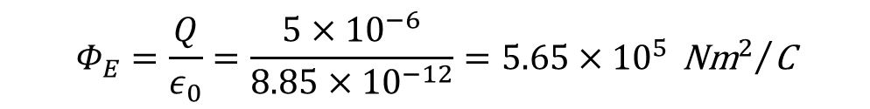
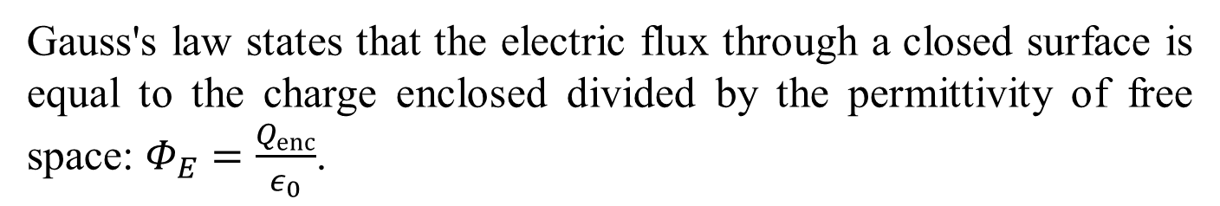
Question 3: ANSWER
(a) Statement of Gauss's Law
Gauss's law states that the electric flux through a closed surface is equal to the charge enclosed divided by the permittivity of free space: $Φ_{E}=\frac{Q_{enc}}{ε_{0}}$.
(b) Flux Calculation
$$Φ_{E}=\frac{Q}{ε_{0}}=\frac{5×{10}^{−6}}{8.85×{10}^{−12}}=5.65×{10}^{5} {{\text{Nm}}^{2}}/{\text{C}}$$
(c) Flux for Larger Radius
The flux remains the same since it depends only on the enclosed charge, not on the size of the enclosing surface.

Slide 14
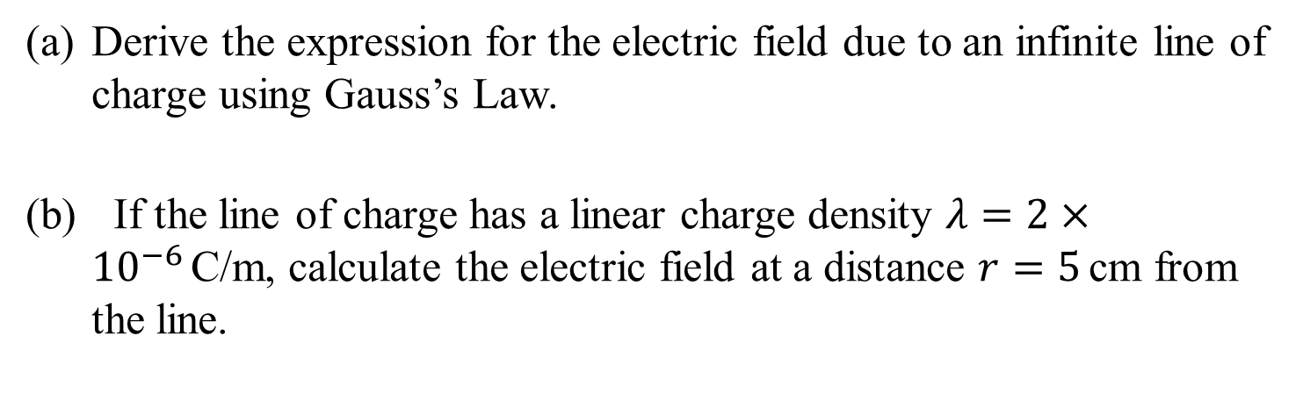
Question 4
Derive the expression for the electric field due to an infinite line of charge using Gauss’s Law.
If the line of charge has a linear charge density $λ=2×{10}^{−6}$C/m, calculate the electric field at a distance $r=5$cm from the line.

Slide 15
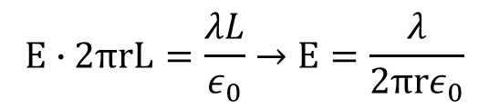
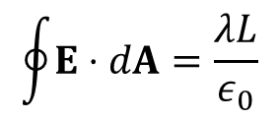
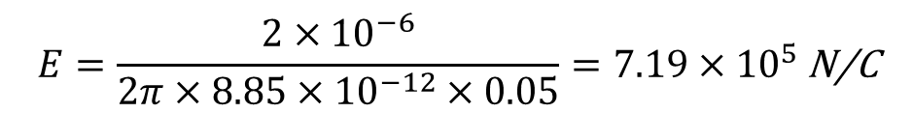
Question 4: ANSWER
(a) Deriving the Electric Field
$$\oint{E}⋅dA=\frac{λL}{ε_{0}}$$
For a cylindrical Gaussian surface:
$$E∙2πrL=\frac{λL}{ε_{0}}→E=\frac{λ}{2πrε_{0}}$$
(b) Electric Field Calculation
$$E=\frac{2×{10}^{−6}}{2π×8.85×{10}^{−12}×0.05}=7.19×{10}^{5} \text{N}\text{/}\text{C}$$

Slide 16
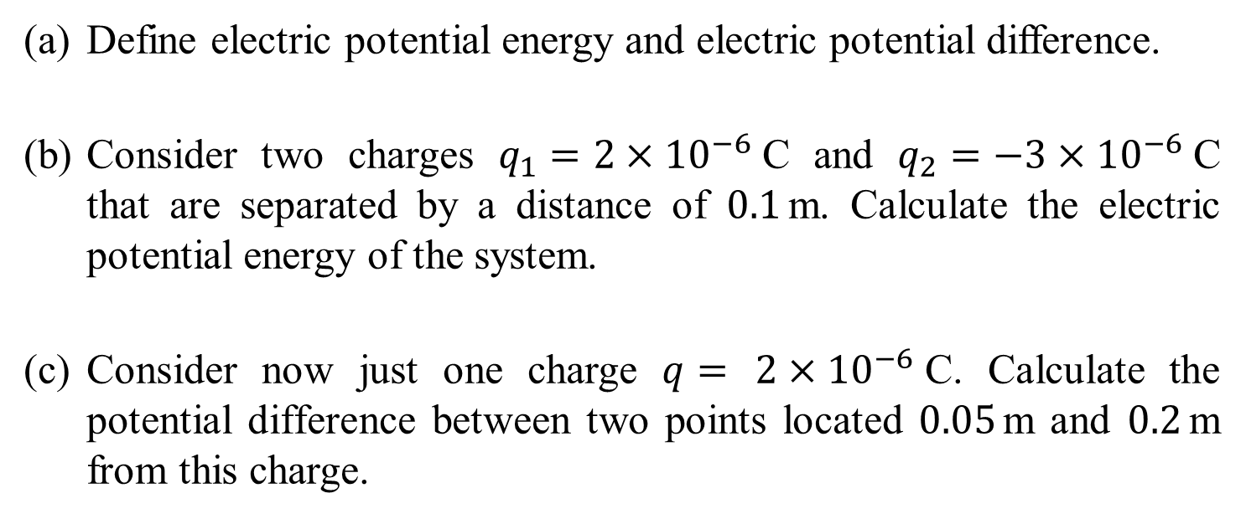
Question 5
Define electric potential energy and electric potential difference.
Consider two charges $q_{1}=2×{10}^{−6}$C and $q_{2}=−3×{10}^{−6}$C that are separated by a distance of $0.1$m. Calculate the electric potential energy of the system.
Consider now just one charge $q=$ $2×{10}^{−6}$C. Calculate the potential difference between two points located $0.05$m and $0.2$m from this charge.

Slide 17

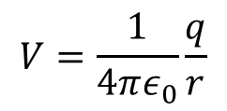
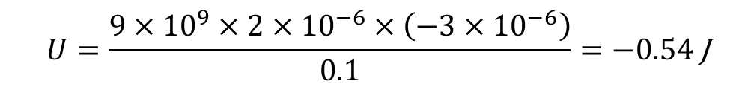
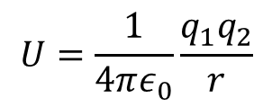

Question 5: ANSWER
(a) Definitions
Electric Potential Energy: The work done in bringing a charge from infinity to a point in an electric field.
Electric Potential Difference: The work done in moving a unit positive charge between two points in an electric field.
(b) Electric Potential Energy Calculation
$$U=\frac{1}{4πε_{0}}\frac{q_{1}q_{2}}{r}$$
$$U=\frac{9×{10}^{9}×2×{10}^{−6}×\left(−3×{10}^{−6}\right)}{0.1}=−0.54 \text{J}$$
(c) Electric Potential difference Calculation
$$V=\frac{1}{4πε_{0}}\frac{q}{r}$$
Potential at $0.05$m: $V_{1}=\frac{1}{4πε_{0}}\frac{q}{0.05}=3.6×{10}^{5}$V
Potential at $0.2$m: $V_{2}=\frac{1}{4πε_{0}}\frac{q_{1}}{0.2}=0.9×{10}^{5}$V
Potential Difference: $ΔV=V_{1}−V_{2}=2.7×{10}^{5}$V

Slide 18
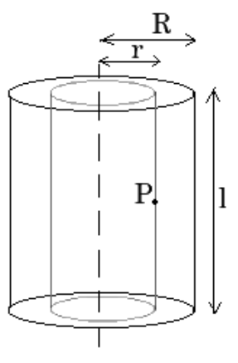

Question 6
A long solid cylinder with radius $R$ carries a uniform charge per unit length $λ$. Use Gauss’s Law to find the electric field at a distance $r$ from the axis for $r<R$ and $r>R$.

Slide 19
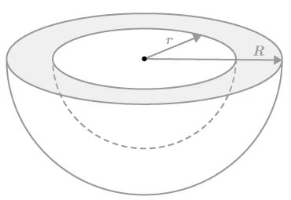



Question 6
(b) Consider a spherical shell with inner radius $R_{1}$ and outer radius $R_{2}$, carrying a uniform charge density $ρ$ within its volume. Using Gauss’s Law, derive the expression for the electric field at a distance $r$ from the center for $r<R_{1}$, $R_{1}<r<R_{2}$, and $r>R_{2}$.
$$R_{1}$$
$$R_{2}$$

Slide 20
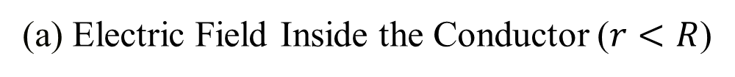
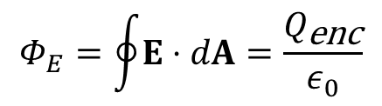
Question 6: ANSWER
(a) Electric Field Inside the Conductor ($r<R$)
Gauss's Law states that the electric flux $Φ_{E}$
$$Φ_{E}=\oint{E}⋅dA=\frac{Q_{\text{enc}}}{ε_{0}}$$

Slide 21
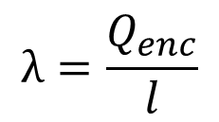
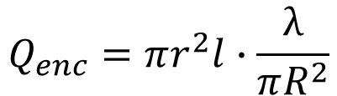
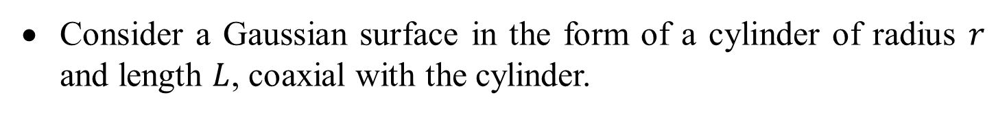
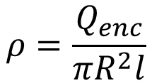

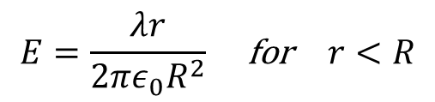
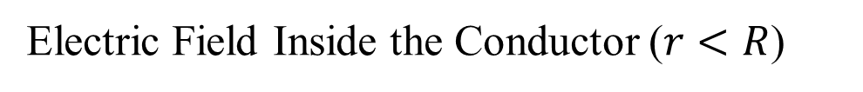
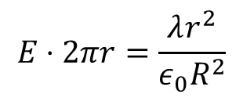
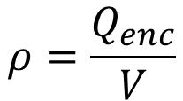

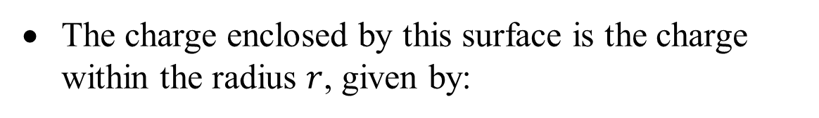
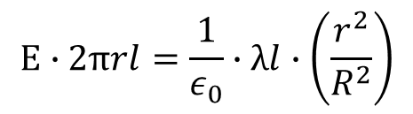
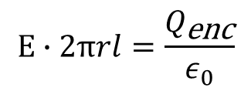
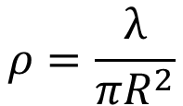
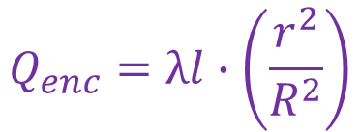
Question 6: ANSWER
Electric Field Inside the Conductor ($r<R$)
Consider a Gaussian surface in the form of a cylinder of radius $r$ and length $L$, coaxial with the cylinder.
The charge enclosed by this surface is the charge within the radius $r$, given by:
$$ρ=\frac{Q_{enc}}{V}$$
$$ρ=\frac{Q_{enc}}{πR^{2}l}$$
$$λ=\frac{Q_{enc}}{l}$$
$$ρ=\frac{λ}{πR^{2}}$$
$$Q_{in}=ρV$$
$$Q_{enc}=πr^{2}lρ$$
$$Q_{enc}=πr^{2}l∙\frac{λ}{πR^{2}}$$
$$Q_{enc}=λl∙\left(\frac{r^{2}}{R^{2}}\right)$$
$$E∙2πrl=\frac{Q_{\text{enc}}}{ε_{0}}$$
$$E∙2πrl=\frac{1}{ε_{0}}∙λl∙\left(\frac{r^{2}}{R^{2}}\right)$$
$$E⋅2πr=\frac{λr^{2}}{ε_{0}R^{2}}$$
$$E=\frac{λr}{2πε_{0}R^{2}} \text{for} r<R$$

Slide 22
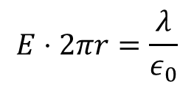
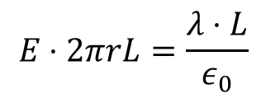

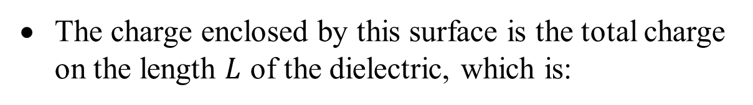
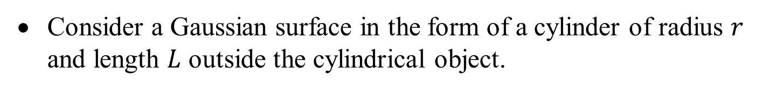
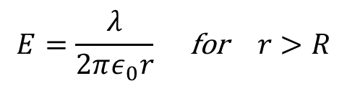
Question 6: ANSWER
Electric Field Outside the Conductor ($r>R$)
Consider a Gaussian surface in the form of a cylinder of radius $r$ and length $L$ outside the cylindrical object.
The charge enclosed by this surface is the total charge on the length $L$ of the dielectric, which is:
$$Q_{\text{enc}}=λ⋅L$$
Using Gauss’s Law:
$$E⋅2πrL=\frac{λ⋅L}{ε_{0}}$$
$$E⋅2πr=\frac{λ}{ε_{0}}$$
$$E=\frac{λ}{2πε_{0}r} \text{for} r>R$$

Slide 23




Question 6: ANSWER
(b) Electric Field Inside the Inner Radius ($r<R_{1}$)
For $r<R_{1}$, consider a Gaussian surface as a sphere of radius $r$ centered at the origin.
Since the Gaussian surface is inside the inner radius of the shell, the charge enclosed by this surface is zero:
$$Q_{\text{enc}}=0$$
By Gauss’s Law:
$$\oint{E}⋅dA=E⋅4πr^{2}=\frac{0}{ε_{0}}=0$$
$$E=0 \text{for} r<R_{1}$$

Slide 24








Question 6: ANSWER
Electric Field Within the Shell ($R_{1}<r<R_{2}$)
For $R_{1}<r<R_{2}$, consider a Gaussian surface as a sphere of radius $r$, where $r$ lies within the shell.
The charge enclosed by this surface is the charge within the volume from $R_{1}$ to $r$. The volume of this region is:
$$V_{\text{enc}}=\frac{4}{3}π\left(r^{3}−R_{1}^{3}\right)$$
The enclosed charge $Q_{enc}$ is:
$$Q_{\text{enc}}=ρ⋅V_{\text{enc}}=ρ⋅\frac{4}{3}π\left(r^{3}−R_{1}^{3}\right)$$
$$\oint{E}⋅dA=E⋅4πr^{2}=\frac{ρ⋅\frac{4}{3}π\left(r^{3}−R_{1}^{3}\right)}{ε_{0}}$$
Using Gauss’s Law:
$$E⋅4πr^{2}=\frac{ρ⋅4π\left(r^{3}−R_{1}^{3}\right)}{3ε_{0}}$$
$$E=\frac{ρ\left(r^{3}−R_{1}^{3}\right)}{3ε_{0}r^{2}} \text{for} R_{1}<r<R_{2}$$

Slide 25




Question 6: ANSWER
Electric Field Outside the Shell ($r>R_{2}$)
For $r>R_{2}$, consider a Gaussian surface as a sphere of radius $r$, where $r$ lies outside the shell.
The charge enclosed by this surface is the total charge within the entire volume of the shell:
$$Q_{\text{enc}}=ρ⋅\frac{4}{3}π\left(R_{2}^{3}−R_{1}^{3}\right)$$
$$\oint{E}⋅dA=E⋅4πr^{2}=\frac{ρ⋅\frac{4}{3}π\left(R_{2}^{3}−R_{1}^{3}\right)}{ε_{0}}$$
Using Gauss’s Law:
$$E=\frac{ρ\left(R_{2}^{3}−R_{1}^{3}\right)}{3ε_{0}r^{2}} \text{for} r>R_{2}$$

Slide 26

Question 7
Define electric potential energy and electric potential difference. Explain their relationship.
Calculate the work done in moving a charge $q=2×{10}^{−6}$C between two points in an electric field, given that the potential difference between the points is $V=100$V.
Two charges $q_{1}=1×{10}^{−6}$C and $q_{2}=−2×{10}^{−6}$C are placed 0.1 m apart. Calculate the potential energy of the system.

Slide 27










Question 7: ANSWER
(a) Electric potential energy $U$
Electric potential energy $U$ is the energy a charge has due to its position in an electric field.
The electric potential difference $V$ is the work done per unit charge in moving a charge between two points in an electric field:
$$V=\frac{W}{q}$$
(b) Work done $W$
$$W=qV$$
$$W=2×{10}^{−6}×100=2×{10}^{−4} \text{J}$$
(c) The potential energy $U$
$$U=\frac{q_{1}q_{2}}{4πε_{0}r}$$
$$U=\frac{\left(1×{10}^{−6}\right)\left(−2×{10}^{−6}\right)}{4π×8.85×{10}^{−12}×0.1}=−1.8×{10}^{−1} \text{J}$$

Slide 28

Question 8
Derive the relationship between electric potential $V$ and electric field $E$.
Explain how the electric field can be calculated from the electric potential using the concept of the gradient.
Calculate the electric field at a point where the electric potential is given by $V\left(x\right)=5x^{2}+2x−3$V, where $x$ is in meters.
If the electric field in a region is given by $E=−5x$N/C, find the potential difference between two points separated by 2 m along the x-axis.

Slide 29





Question 8: ANSWER
(a) Relationship between $V$ and $E$
The electric field $E$ is related to the electric potential $V$ by the negative gradient of $V$:
$$E_{x}=−\frac{dV}{dx}$$
(b) The electric field $E$
The electric field $E$ at a point is the (negative) rate of change of the electric potential with respect to position. It points in the direction of the greatest decrease of potential.

Slide 30






Question 8: ANSWER
(c) Calculate the electric field
For the potential $V\left(x\right)=5x^{2}+2x−3$:
$$E_{x}=−\frac{dV}{dx}=−\frac{d}{dx}\left(5x^{2}+2x−3\right)=−\left(10x+2\right) \text{V}\text{/}\text{m}$$
At $x=1$ m:
$$E_{x}=−\left(10\left(1\right)+2\right)=−12 \text{V}\text{/}\text{m}$$
(d) potential difference $ΔV$ between two points
$$ΔV=−\int_{x_{0}}^{x_{0}+2}{Edx}=−\int_{x_{0}}^{x_{0}+2}{−5x dx}={\left[\frac{5x^{2}}{2}\right]}_{x_{0}}^{x_{0}+2}$$

Slide 31





Question 8: ANSWER
$$ΔV=−\int_{x_{0}}^{x_{0}+2}{Edx}=−\int_{x_{0}}^{x_{0}+2}{−5x dx}={\left[\frac{5x^{2}}{2}\right]}_{x_{0}}^{x_{0}+2}$$
$$ΔV={\left[\frac{5x^{2}}{2}\right]}_{x_{0}}^{x_{0}+2}=\frac{5{\left(x_{0}+2\right)}^{2}}{2}−\frac{5{\left(x_{0}\right)}^{2}}{2}$$
$$ΔV=\frac{5\left({x_{0}}^{2}+4x_{0}+4\right)}{2}−\frac{5{x_{0}}^{2}}{2}$$
$$ΔV=10x_{0}+10$$
The potential increases by $10x_{0}+10$ V as you move 2 m in the positive direction of the x-axis. Where $x_{0}$ is the initial position on the x-axis.

Slide 32
Q&A? Office hours:

Slide 33


Question 9-Extension
A metal sphere of radius, r₀ = 0.44 m, carries a charge Q = 0.50 μC. Equipotential surfaces are to be drawn for 100 V intervals outside the sphere.
Determine the radius r, of
the first,
the tenth, and
the 100th equipotential from the surface.
$$r$$
$$r_{0}$$

Slide 34










Question 9: ANSWER
The potential at the surface of the sphere is $V0= \frac{1}{4πε_{0}} \frac{Q}{r_{0}}$
$$r$$
The potential outside the sphere is $V= \frac{1}{4πε_{0}}$ $\frac{Q}{r}=V_{0} \frac{r_{0}}{r}$ and decreases as you move away from the surface.
$$r_{0}$$
$$V_{0}= \frac{Q}{4πε_{0}r_{0}} Eq.(1)$$
Substitute (1) into (2) ${→ V}_{n}=V0\frac{r_{0}}{r_{n}}$
$$V_{n}= \frac{Q}{4πε_{0}r_{n}} Eq.(2)$$
The difference in potential between a given location and the surface is to be a multiple of 100 V.
$$r_{n}= \frac{V0}{\left[V0−\left(100×n\right)\right]}{ r}_{0}$$
$$V0−V0\frac{r_{0}}{r_{n}}=100 n$$
$$→ V0−V_{n}=100 n$$

Slide 35






Question 9: ANSWER
$V0= \frac{1}{4πε_{0}} \frac{Q}{r_{0}}= 8.988 ×{10}^{9} \text{N}\text{.}\text{m}\text{2}\text{.}\text{C}\text{−}2 \text{× }\left(\frac{0.50 ×{10}^{−6}C}{0.44 m}\right)$ = 10,214 V
$$r_{n}= \frac{V0}{\left[V0−\left(100×n\right)\right]}{ r}_{0}$$
$$r$$
$$r_{0}$$
${\text{(}\text{a}\text{)} r}_{1} =\frac{10,214 V}{\left[10,214 V−\left(100×1\right) V\right]}×\text{ 0.44 }\text{m}$= 0.44 m
${\text{(}\text{b}\text{)} r}_{10} =\frac{10,214 V}{\left[10,214 V−\left(100×10\right) V\right]}×\text{ 0.44 }\text{m}$= 0.49 m
${\text{(}\text{c}\text{)} r}_{100} =\frac{10,214 V}{\left[10,214 V−\left(100×100\right) V\right]}×\text{ 0.44 }\text{m}$ ≃ 21 m

Slide 36


Question 10-Extension
Point 𝑎 is 26 cm north of a -3.8 μC point charge, and point 𝑏 is 36 cm west of the charge. Determine
V_{b} $−$ V_{a} and
$\vec{E}$_{b} $−$ $\vec{E}$_{a} (magnitude and direction).

Slide 37





Question 10: ANSWER
(a) Determine V_{b} $−$ V_{a}
The potential due to a point charge is given by the equation below.
$$V_{ba}=V_{b}−V_{a}$$
$V_{ba}= \frac{1}{4πε_{0}}\frac{q}{r_{b}}$ $−$ $\frac{1}{4πε_{0}}\frac{q}{r_{a}}$
$$V_{ba}=\frac{q}{4πε_{0}}\left(\frac{1}{r_{b}}−\frac{1}{r_{a}}\right)$$
$V_{ba}= 8.988 ×{10}^{9} \text{N}\text{.}\text{m}\text{2}\text{.}\text{C}\text{−}2$ ×$\left(−3.8 ×{10}^{−6} \text{C}\right)$ × $\left(\frac{1}{0.36 m}−\frac{1}{0.26 m}\right)$
$$V_{ba}= 3.6 104 V$$

Slide 38










Question 10: ANSWER
(b) Determine $\vec{E}$_{b} $−$ $\vec{E}$_{a} (magnitude and direction)
$\vec{E}b$ = $\frac{1}{4πε_{0}}$ $\frac{\left|q\right|}{r_{b}^{ 2}} \hat{ℹ}$
= $\frac{8.988 ×{10}^{9} \text{N}\text{.}\text{m}\text{2}\text{.}{\text{C}}^{−2} \left(3.8 ×{10}^{−6} C\right)}{{\left(0.36 m\right)}^{2}}$ $\hat{ℹ}$
= 2.636 ×10⁵ V. $\text{m}\text{−1}$ $\hat{ℹ}$
$\vec{E}a$ = $−$ $\frac{1}{4πε_{0}}$ $\frac{\left|q\right|}{r_{a}^{ 2}}$ $\hat{j}$
= $−$ $\frac{8.988 ×{10}^{9} \text{N}\text{.}\text{m}\text{2}\text{.}{\text{C}}^{−2} \left(3.8 ×{10}^{−6} C\right)}{{\left(0.26 m\right)}^{2}} \hat{j}$
= $−$5.054 ×10⁵ V. $\text{m}\text{−1}$ $\hat{j}$
$\vec{E}b$ $−$ $\vec{E}a$ = 2.636 ×10⁵ V. $\text{m}\text{−1}$ $\hat{ℹ}$ + 5.054 ×10⁵ V. $\text{m}\text{−1}$ $\hat{j}$
$$\left|\vec{E}b\text{ − }\vec{E}a \right|= \sqrt{{\left(\text{2.636 }\text{×10}\text{5} \text{V}\text{.}\text{m}\text{−1}\right)}^{2}+{\left(\text{5.054 }\text{×10}\text{5} \text{V}\text{.}\text{m}\text{−1}\right)}^{2}}$$
= 5.7 ×10⁵ V. $\text{m}\text{−1}$
θ = $\tan^{−1}{\frac{\left|\vec{E}a\right|}{\left|\vec{E}b\right|}}$
$$θ=\frac{\text{5.054 }\text{×10}\text{5}}{\text{2.636 }\text{×10}\text{5}}=62°$$

Slide 39

Question 11-Extension
Three point charges are arranged at the corners of a square of side, 𝑙. What is the potential at the fourth corner (point A), taking V = 0 at a great distance?

Slide 40



Question 11: ANSWER
The potential at the corner is the sum of the potentials due to each of the charges, using the equation below.
$V = \frac{1}{4πε_{0}} \frac{3Q}{l}$ + $\frac{1}{4πε_{0}}$ $\frac{Q}{\sqrt{2}l}$ + $\frac{1}{4πε_{0}}$ $\frac{−2Q}{l}$
$V= \frac{1}{4πε_{0}}$ $\frac{Q}{l}$ $\left(1+ \frac{1}{\sqrt{2}}\right)$
$V= \frac{1}{4πε_{0}}$ $\frac{\sqrt{2}Q}{2l}$ $\left(\sqrt{2}+1\right)$

